Slide 1



248 BAY SERIES
Owner’s Manual and Quick-Reference Guide 2022
WWW.SEAPROMFG.COM

Slide 2


TABLE OF CONTENTS
Table of Contents 2 Introduction 3 Model Information 4 Key Information 5 Specifications 6 Standard Features 7 Optional Features & Hull Color Options 8 Hull Identification Number 9 Boating Safety
General Safety 10
U.S.C.G. Minimum Required Equipment 11 Carbon Monoxide Warning 12 Boating Navigation Rules 13 Safety Labels 15 Pollution Regulations 16
Systems and Components
Helm Station 17 Battery Selection Switch 17 Engine Shutdown Safety Switch 18 Engine Controls 19 Steering Controls 20 Helm Switch Panel 21 Compass 21 Bilge Pump 22 Livewells & Sea Cocks 23 Navigation / Anchor Lighting 25 Trim tab Control 26
2
Static Jack Plate 26 Hydraulic Jack Plate 27 Power-Pole® 27 Raw Water Wash Down 28 Fresh Water System 29
Integrated Fuel System 30
Fuel System Diagram 31 Fuel System Performance 32 Fuel / Water Separator 33
Wiring Color Codes 34
Maintenance 35 Storage 38 Recommissioning 39
Warranty 40
Contact Information 41
248 BAY SERIES

Slide 3
THE RETURN OF A LEGEND...
Thank You for purchasing a SEA PRO boat. Here at SEA PRO BOATS, to say that we pride ourselves on craftsmanship is an understatement. A lot of boat manufacturers claim to offer the best “value” in their respective market, but our mission is to build the most durable, comfortable, functional and safest boats of any market.
We carefully scrutinize every part and all raw materials by every supplier as if our own family’s safety depends on it. And in fact, it does! We not only use our SEA PRO boats personally, but we consider every SEA PRO owner, whether old or new, part of the SEA PRO FAMILY. Little makes us happier than receiving pictures and letters from SEA PRO boat owners building memories and enjoying their boat. Welcome to the family.
If you’re in the market for a center console boat, look long and hard. Compare all the details and ask questions. Or better yet, come to our facility for a plant tour and see for yourself all the high-tech materials and construction methods we employ that we believe set us apart from any other brand on the market.
Sincerely,
Jimmy Hancock and Preston Wrenn
Visit our website at www.seapromfg.com for information on the entire SEA PRO model lineup.
172 BAY SERIES
3

Slide 4
2023 MODEL INFORMATION
This manual contains information on the following SEA PRO models:
BAY SERIES
248
NOTE:
This manual is being provided as a reference and informational tool. SEA PRO BOATS suggests that you maintain a copy of this manual on board for future use and reference. The information contained is subject to change.
When your SEA PRO boat requires Service, Maintenance or Warranty Work, it should be taken to an Authorized and Approved
SEA PRO BOATS dealer. To find a SEA PRO BOATS dealer near you call 1-803-694-2644.
Ver. 1.0.248.17
4 248 BAY SERIES

Slide 5
KEY INFORMATION
BOAT INFORMATION
MODEL #: |  | HULL SERIAL #
PURCHASE DATE: |  | REGISTRATION #:
IGNITION KEY #:
ENGINE INFORMATION
ENGINE MAKE: |  | MODEL #:
SERIAL #:
PROPELLER INFORMATION
MAKE: |  | # OF BLADES:
DIAMETER: |  | PITCH:
PART #
OPTIONAL EQUIPMENT
MAKE: |  | MODEL #:
SERIAL #:
DEALER INFORMATION
NAME: |  | PHONE #:
STREET ADDRESS: |  | CITY:
STATE: |  | ZIP CODE:
SALES PERSON:
248 BAY SERIES
5

Slide 6
SPECIFICATIONS
248 SPECIFICATIONS
Length | 24’ 8”
Beam | 8’ 9”
Fuel Capacity | 70 Gal
Max Horse Power | 300 H.P.
Live Well (2 EA.) | 30 Gal
Deadrise @ Transom | 15 Degrees
Draft | 15”
Fish Box | 150 Quarts
Dry Weight (No Motor) | 3000 LBS.
6
248 BAY SERIES

Slide 7
STANDARD FEATURES
Hand Laid Fiberglass Hull
100% All Composite Construction = No Rot
10 Year Transferable Hull Warranty
Lifetime Hardware Warranty
5 Year Bow to Stern Warranty
Hydraulic Tilt Steering
Composite Transom
Engineered Custom Fiberglass Stringer System
SIMRAD Electronics
Custom High Volume Cockpit Drains
All Stainless Steel Forged Thru Hull Fittings
All Stainless Steel Pop Up Cleats (5)
Stainless Steel Rub Rail
Stainless Steel Steering Wheel with Knob
Custom Powder Coated Leaning Post
Custom Dash with Stainless Steel Switches
Forward and Rear Casting Decks
Pop Up Rear Bench Seat with Dry Storage
Bow Lockable Rod Storage (2) with LED Lighting
Large Insulated Fish Box
Custom Anchor Locker
Under Gunwale Rod Storage with Reel Pads
Under Gunwale LED Lighting
248 BAY SERIES
Aerated and Pressurized Bait Wells (2) with LED Lighting
and No Clog Drain System
Easy Access Lazarette for Batteries and Seacocks
Easy Access Trolling Motor Battery Floor Locker
Trolling Motor Panel with TM Plug and Trim Switch
Automatic Bilge Pump
Deluxe Console with Storage
Windshield
Compass / Horn
Stainless Steel Cup Holders (6)
LED Courtesy Lights
Yachts Style Non Skid
1/2 Swim Platform with 3-Step Ladder
Deluxe Stainless Steel Bow and Stern Eyes
Raw Water Washdown System
Stainless Steel Flush Rod Holders (4)
Dual High Speed Pickups with Sea Cocks
Polk Audio Sound System with 4 Speakers
12 volt DC Outlet
Dual Battery Switch
Static (Manual) Jack Plate
7

Slide 8








OPTIONAL FEATURES & HULL COLOR OPTIONS
Optional Features:
Custom Soft T-Top with Radio box
Deluxe Fiberglass T-Top
Trim Tabs
SIMRAD Electronics
Deluxe Stereo Upgrade (Amp, Sub, 2 add’l Speakers)
Power Pole
Deluxe Leaning Post with Tackle Storage
Deluxe Tackle Storage (2)
Tempered Glass Windshield
Motor Guide Xi5 Trolling Motor
Battery Charging System
Pump Out Head
Porta Potty
Underwater Lights
Bow & Stern Casting Chairs
Flip-Up Leaning Post Bolsters
Deluxe Café (Brown) Upholstery
Bow Cushion
Helm Pad
Mister Cooling System
Turbo Swing Ski Tow
Optional Hull Colors
8
Fresh Water Tank with Pull-Out Shower
Hydraulic Jack Plate
Bow and/or Stern Casting Chair
Custom Canvas Options (Spray Shield, Gull Wings, etc.)
Fender Pro Bumper Attachments
Hull Color Options:
I CE BLUE
PLATINUM
SEA FOAM
BLACK
ROYAL
CAROLINA
SEA CREATURE
WHITE
SHARK GREY
248 BAY SERIES

Slide 9
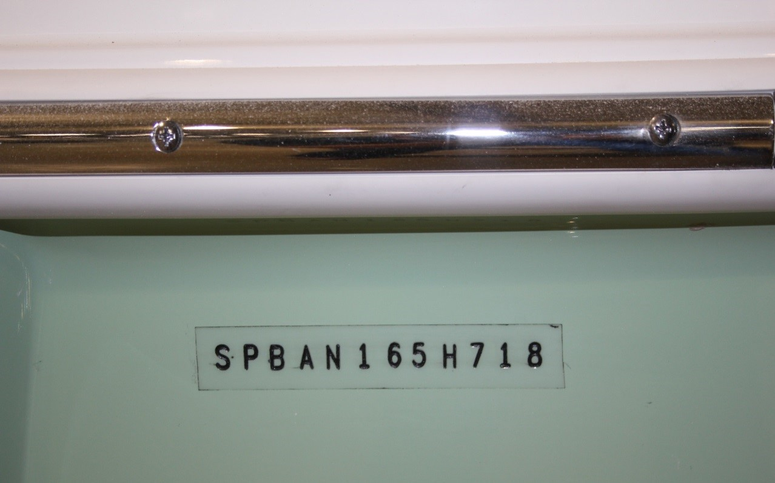
HULL IDENTIFICATION NUMBER & REGISTRATIONS
SEA PRO BOATS has a permanent record of your boat’s Hull Identification Number. This Hull Identification Number is recorded during the manufacturing process. The Hull Identification Number is a 12 digit code located on the right side of the transom, just under the rub rail. When contacting your dealer regarding maintenance or warranty inquiries, please have your Hull Identification Number and SEA PRO Model Number on hand. This information can also be found on your copy of the SEA PRO Warranty Certificate. Federal and State Laws require a power boat to be registered in the state of primary use. Registration numbers and validation stickers must be displayed according the local and state regulations. The registration certificate must be kept on board when boating. The Hull Identification Number is required on the registration form. The Hull Identification Number should be included on all documents and correspondence with the dealer or SEA PRO BOATS.
SPB XX XXX X X XX
Model Year (2 digits)
Year of Build (1 Digit)
Month of Build (1 Digit)
Serial Number (3 Digits)
Model Identification (2 Digits)
Manufacturer’s I.D. Code (3 Digits)
248 BAY SERIES
9

Slide 10
BOATING SAFETY
GENERAL SAFETY
NOTICE: As a boat owner or operator, YOU are responsible for Your Personal Safety, the Safety of Your Passengers , and the Safety of Other Boaters. SEA PRO BOATS suggests taking a Boating Safety Course in order to prepare for safe and enjoyable experiences on the water. Boating Education Programs are offered by various organizations, such as the U.S. Power Squadron, United States Coast Guard Auxiliary, and State and Local Boating Authorities.
More information can be found by contacting the U.S.
Coast Guard’s Boating Safety Division website:
people are swimming or participating in other water activities nearby, and when in close proximity to structures and other boats
Knowing the rules of the water and practicing them at all times
Being familiar with the traffic and geography of the body of water on which your are boating
Keeping safe distances from fishermen and boats not under power
Being mindful of your wake. You are responsible for any damage caused
Maintaining and ensuring your boat and it’s systems are in proper working order
Keeping all Legally Mandated Equipment is in proper working condition
www.uscgboating.org 1-800-368-5647
Boating Safety Means:
Know the limitations of your boat and the capabilities and knowledge of the operator
Never operate your boat while under the influence of drugs or alcohol
Be aware of Your Passenger’s Safety at all times
Reduce speeds when visibility is limited, in foggy weather, in rough waters, in congested areas, when
10
248 BAY SERIES

Slide 11
BOATING SAFETY
U.S. COAST GUARD MIINIMUM EQUIPMENT REQUIREMENTS FOR RECREATIONAL VESSELS
The U.S. Coast Guard requires that every recreational vessel maintain the following minimum safety equipment in working condition at all times while your boat is in operation. SEA PRO BOATS also recommends that you consult with your State and Local Boating Authorities for any additional equipment and safety requirements .
SOUND PRODUCING DEVICES:
Horn or whistle recommended to signal intentions or position. Your SEA PRO boat comes standard with an
electric horn. SEA PRO BOATS recommends maintaining a
secondary sound producing source on board at all times in case of emergency situations.
PERSONAL FLOTATION DEVICES (PFD’S):
One Type I, II, III or V per person plus one Type IV throw able device. PFD’s must be Coast Guard Approved, wearable by the intended user and readily accessible. The Type IV throw able device must be located such that it is immediately available.
NAVIGATION LIGHTS:
Sidelights, stern light, masthead light and a 360º all- around white anchor light capable of being lit
independently from the red/green/white running lights.
ADDITIONAL SUGGESTED EQUIPMENT:
FIRE EXTINGUISHERS:
In addition to the Minimum Required Equipment, SEA PRO BOATS suggests the following items are on board for a safe boating experience:
For Vessels up to 26’ in length: One B-I any type. For Vessels 26’ to 39.4’: One B-II or two B-I.
For Vessels 40’ to 65’: One B-II and one B-I or three B-I.
First Aid Kit
Compass (properly adjusted)
Charts & Maps of the waters and local area
Waterproof Flashlights
Mooring Lines
Tool Kit (basic hand tools, Bulbs, Fuses)
Marine Radio
VISUAL DISTRESS SIGNALS (ON COASTAL WATERS, GREAT LAKES, AND RIVER MOUTHS GREATHER THAN 2 MILES WIDE):
Minimum of (3) day-use and (3)night-use or (3) day/night combination pyrotechnic devices. Non-pyrotechnic
substitutes: (1) orange flag (day-use) and (1) electric S-O-S signal light (night-use).
248 BAY SERIES
11

Slide 12
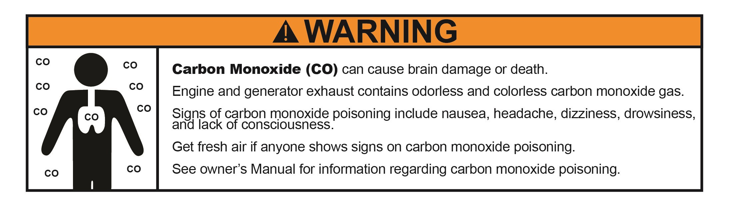
BOATING SAFETY
Carbon Monoxide (CO)
passenger begins to suffer from any of these symptoms, immediately move them to fresh air and investigate possible causes. Immediately take corrective action and seek Medical Attention if necessary.
Carbon Monoxide can accumulate anywhere around the vessel, especially near back decks, swim platforms, the helm and inside enclosed areas.
Potential causes of Carbon Monoxide gas accumulation and/or concentration include:
A blockage of exhaust by a nearby obstruction, dock, or barrier
Idling in place for a prolonged period of time
Operating the vessel at a slow speed
Operating the vessel at a high bow angle
Wind blowing from the rear (Stern) toward
occupants
Exhaust from other vessels nearby or in confined areas
Always maintain good air circulation across the areas of occupancy. Inspect the exhaust systems regularly.
Operate any fuel burning appliances in areas with good ventilation and where fresh air can circulate.
Carbon Monoxide is a colorless, odorless, poisonous gas that is contained in the exhaust produced by engines, generators and other fuel burning appliances. When inhaled it prevents the absorption of oxygen and can be fatal.
Signs and Symptoms of Carbon Monoxide poisoning may include:
Headache
Weakness
Dizziness
Nausea or Vomiting
Shortness of breath
Confusion
Blurred Vision
Drowsiness
Loss of consciousness
Do not confuse carbon monoxide poisoning with
seasickness or intoxication. If the vessel operator or a
12
248 BAY SERIES

Slide 13
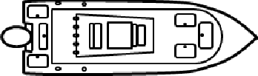
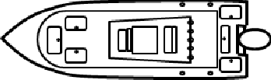
BOATING SAFETY
BOATING NAVIGATION RULES
RIGHT OF WAY
In general, vessels with less maneuverability (Privileged) have right-of-way over more agile vessels (Burdened). Following is an example of vessels that have right-of-way:
Emergency Craft
Vessels aground or not under command
Vessels with restricted maneuverability
Vessels engaged in fishing
Vessels not under power (rowboats, canoes, sailboats, etc.)
There are three types of situations you may encounter with other vessels in which the Navigation Rules apply.
Meeting Head-On:
When two vessels meet head-on, neither has the right-of-way. It is preferred that both vessels decrease speed and turn to the right in order to pass port-to-port. Each vessel may sound the horn or other sound producing device with one short blast signaling a port-to-port pass.
248 BAY SERIES
13

Slide 14
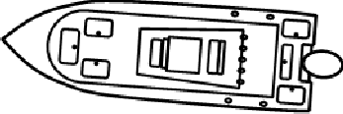


BOATING NAVIAGATION RULES CONT.
Crossing:
When two vessels will cross paths, the vessel to the right is the Privileged Vessel, and has right-of-way, and holds course and speed. The Burdened Vessel must yield and pass to the rear (stern) of the privileged vessel. As with meeting head-on, both vessels may sound the horn or other sound producing device with one short blast.
Overtaking / Passing:
When a vessel (Burdened) overtakes or passes another vessel (Privileged) from behind, the vessel being passed has the right-of-way. The passing vessel must make any adjustments necessary to maintain safety and to remain out of the way of the vessel being passed. The vessel
being passed should maintain it’s course and speed.
If passing on the Port side, each vessel may
sound the horn with two short blasts
If passing on the Star- board side, each vessel
may sound the horn with one short blast
14
248 BAY SERIES

Slide 15
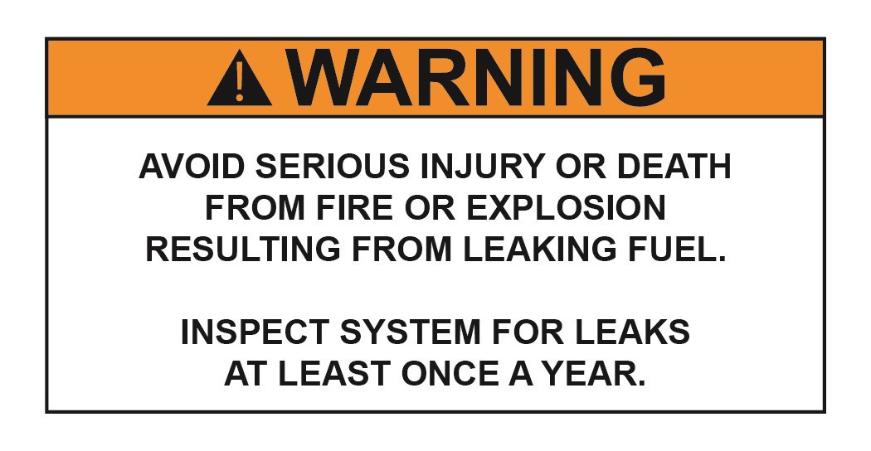
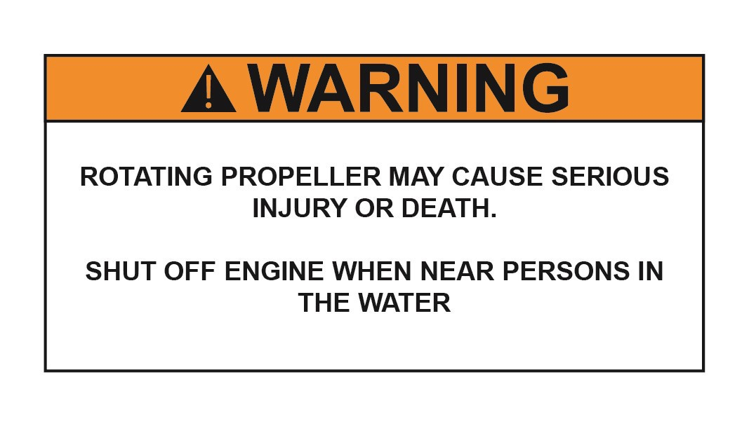
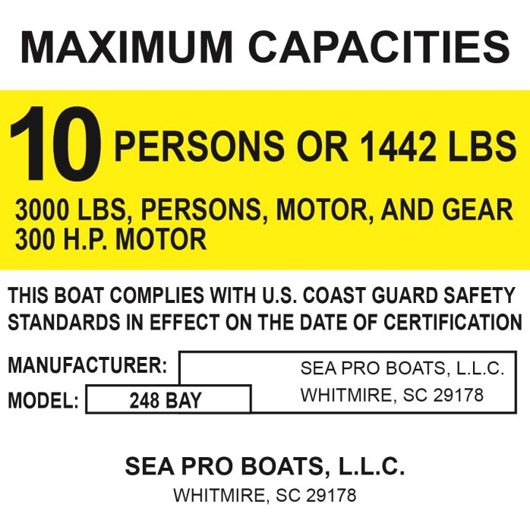
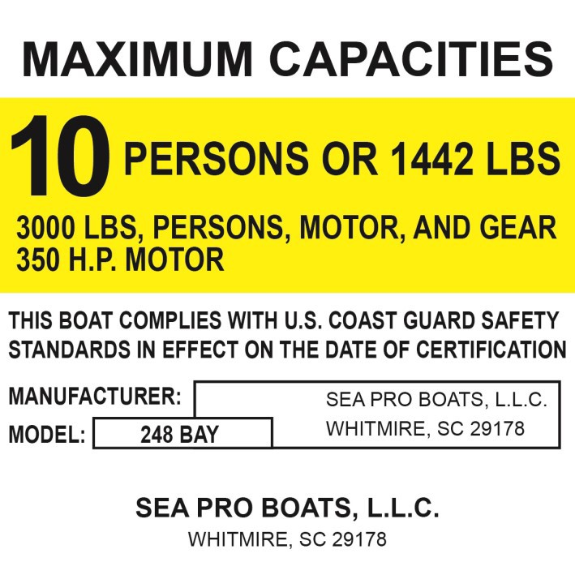
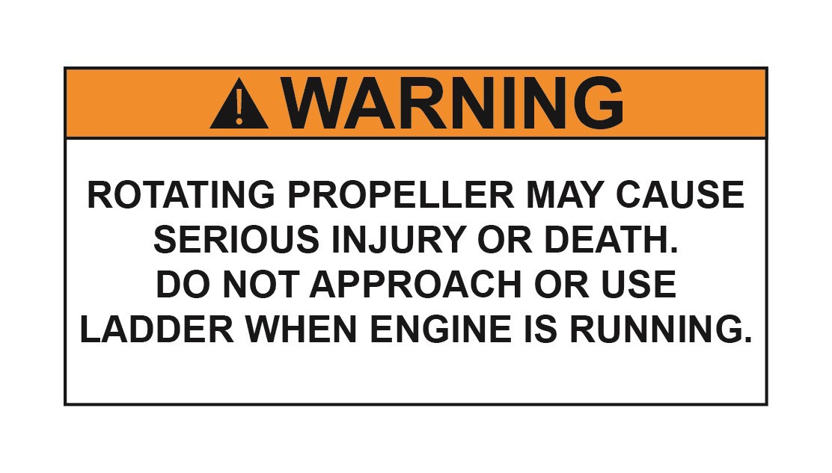

BOATING SAFETY
Safety Labels:
SEA PRO BOATS wants you and your passengers to have a Safe and Enjoyable boating experience. Warning and informational labels are located on your SEA PRO boat calling attention to important information and potential safety concerns. SEA PRO BOATS encourages you to
become familiar with these labels and their location. If
any of these labels become damaged, please contact your local SEA PRO BOATS authorized dealer for replacements.
300 H.P. MOTOR
350 H.P. MOTOR
248 BAY SERIES
15

Slide 16
POLLUTION REGULATIONS
Annex V of Marine Pollution (MARPOL) 73/78 prohibits throwing, discharging, or
depositing any refuse matter of any kind (including trash, garbage, oil, and other liquid pollutants) into the waters of the United States.
The Federal Water Pollution Control Act prohibits the discharge of oil or oily waste upon or into any navigable waters of the United States. This prohibition includes any discharge that causes a film or discoloration of the surface of the water, or causes a sludge or
emulsion beneath the surface of the water. Violators are subject to substantial civil and/or
criminal sanctions, including fines and imprisonment.
The U.S. Coast Guard regulations strictly prohibit dumping of plastic refuse or other garbage mixed with plastic upon or into the waters anywhere. Plastic refuse kills fish, birds, and marine wildlife, can interfere with vessel propellers and can clog water and cooling intakes, and litters the shore and beaches.
16
248 BAY SERIES

Slide 17
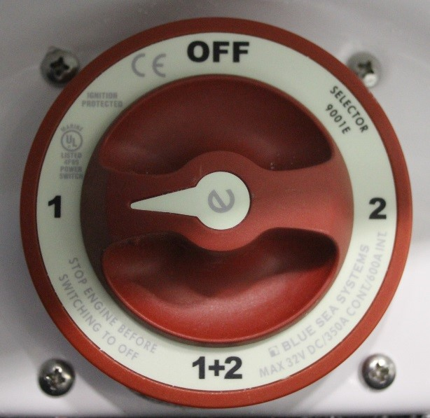
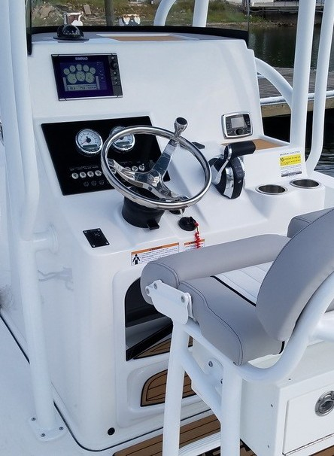
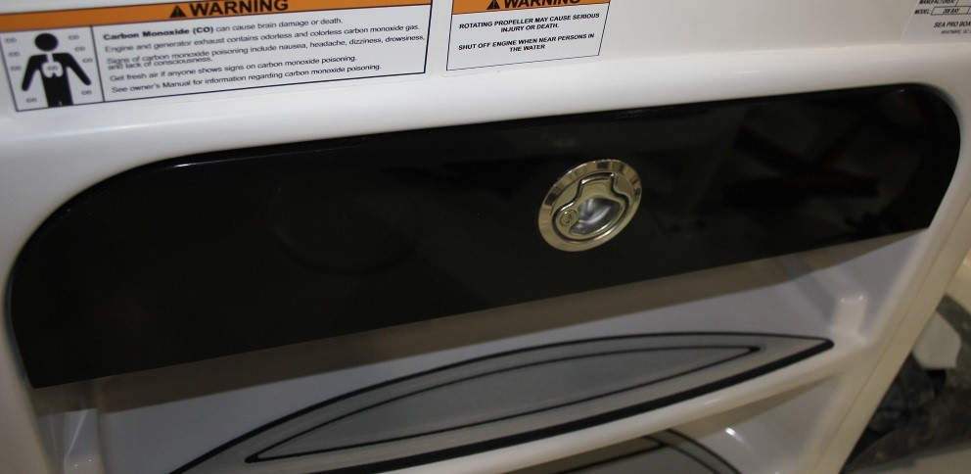
SYSTEMS & COMPONENTS
Helm Station:
The Helm Station is located in the Cockpit of the Vessel, and is the area equipped with the tools and features that
allow operation of the vessel.
Battery Selector Switch
Engine Shutdown Safety
Switch
Engine Controls
Steering Controls
Helm Switch Panel
Instrumentation &
This switch allows the operator to provide power to and disconnect power from the operating systems.
There are four (4) switch positions (OFF, 1, 2, 1 +2) that provide the following functions:
OFF: In this position, power is disconnected from all systems, and should be used when the vessel is being stored or not in use. This prevents any unnecessary power drain from the batteries should an operating system be accidentally left on.
1 or 2: In these positions, all power and current is supplied from either the Starboard (1) or Port (2) battery, and the charging current from the engine will be directed to the selected battery. The opposite battery is
now completely isolated, and does not provide any current to the operating systems nor does it receive any charging current from the engine.
1+2: In this position, both of the batteries are now connected in parallel, with both providing power and current to the operating systems and receiving charging current from the engine.
17
Navigation (*Optional Equipment)
Audio / Stereo (*Optional Equipment)
Compass
*See Owner’s Manuals for Optional Equipment Installed
Battery Selector Switch Compartment & Switch:
Located at the lower part of the Helm is a compartment which contains the Battery Selector Switch.
248 BAY SERIES

Slide 18
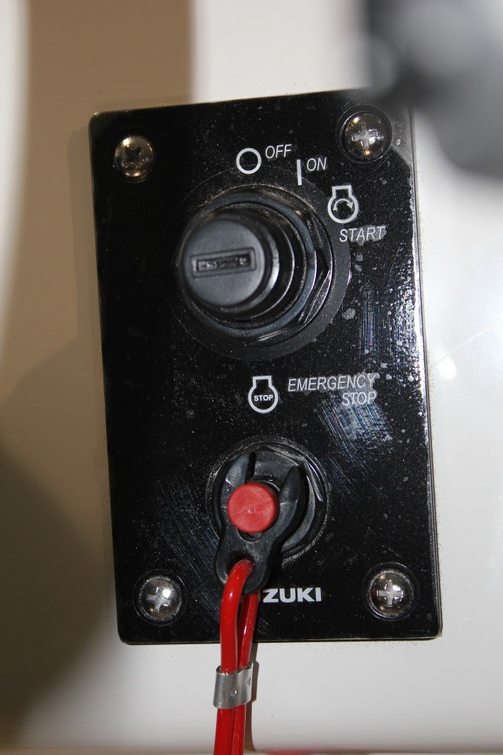
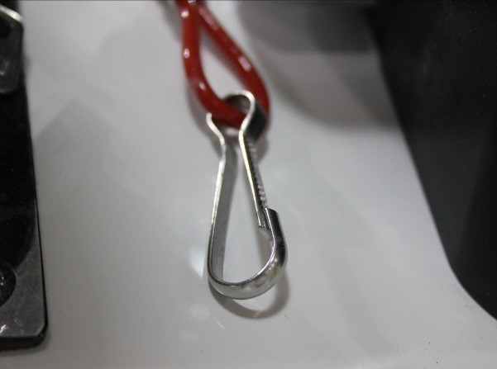
SYSTEMS & COMPONENTS
Engine Shutdown Safety Switch:
Your SEA PRO boat is Equipped with an Engine Shutdown Safety Switch. The Safety Switch is located below the Shift/Throttle Control Unit, on the Ignition Panel, and includes the following components:
When the switch clip is pulled/removed from the Shutdown Switch, the engine will immediately be shut down. This Shutdown control is designed so that if an
emergency occurs, the engine will be shut down and the vessel will not become out of control or a runaway
vessel. The Engine shutdown will occur should the operator leave the Helm/Controls, be accidentally knocked down inside the vessel or be ejected overboard from the vessel. The lanyard should be long enough to prevent inadvertent Engine Shutdown.
Before starting the engine, take the following steps:
Ensure the Switch Clip is fully secured in the
Shutdown Switch
Ensure the Lanyard is not tangled or wrapped around any objects
Secure the Lanyard Operator Clip to the Vessel Operator
WARNING: Never remove or modify the Engine Shutdown Safety Switch. Regularly check that the Shutdown Switch is in working condition. Should the Shutdown Switch become inoperable and does not shut down the Engine when the Switch Clip is removed, have the switch repaired before continuing to operate your vessel.
Shutdown Switch
Switch Clip
Lanyard
Lanyard Operator Clip
18
248 BAY SERIES

Slide 19
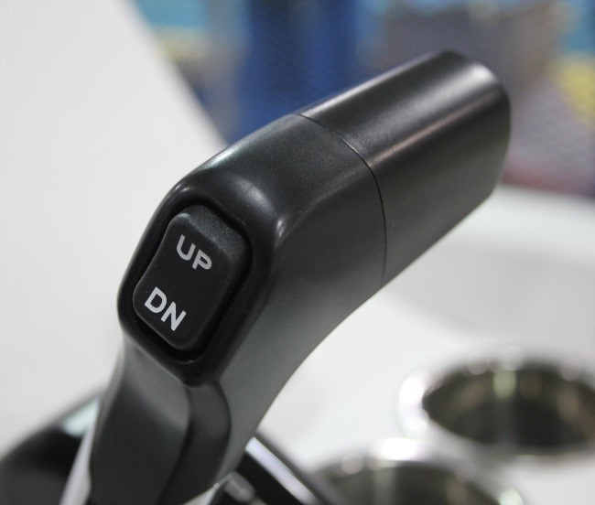
SYSTEMS & COMPONENTS
Engine Controls:
Located on the main horizontal surface, and to the right of the steering are the Engine Controls. These consist of the Ignition, Shift/Throttle Control and Engine Tilt/Trim Control.
Ignition: Every engine comes with a specific Key and/or Push button ignition control. Placing the key into the panel and either turning to the right or pushing the
button will engage the engine starter and will start the motor. Refer to the Engine Owner’s Manual for
Operation and Specifications.
Shift/Throttle Control: Your Sea Pro boat comes with a binnacle style lever that controls the forward, reverse and neutral gear selection, as well as the throttle control. of the motor.
Neutral = Straight Up and Down
Forward = 1st detent position forward of Neutral. Reverse = 1st detent position aft of neutral.
Advancing the binnacle lever beyond the 1st detent in either direction increases the throttle demand.
Your Shift/Throttle control system also includes a Neutral Safety Switch that prevents the engine from
being started while the binnacle lever is in any position other than Neutral. Thus preventing accidental
movement of the vessel when starting the engine.
Refer to the Engine Owner’s Manual for Operation and
248 BAY SERIES
Specifications.
Every Engine and Shift/Throttle Control unit comes with a function allowing the engine to be operated at a higher than idle RPM range while in Neutral for Cold Starting and Warm-Up purposes.
Refer to the Engine Owner’s Manual for Operation and Specifications.
Engine Power Trim / Tilt: All engines mounted on a SEA PRO boat have a Trim & Tilt control module located on the binnacle lever. This
control module allows the operator to control the
position of the outboard motor while at the helm.
Trim refers to the position and range of travel of the motor within the first 20 degrees.
This is the range for operating your vessel while on Plane. Trimming the motor “down” refers to bringing it closer to the transom. Trimming the motor “up” refers to moving it further away. Utilize the Trim to adjust the angle the vessel will run in the water to optimize performance. Tilt refers to the position of the motor
beyond the first 20 degrees and is used when travelling in shallow water or trailering of your vessel.
Refer to the Engine Owner’s Manual for Operation,
Maintenance and Specifications.
19

Slide 20
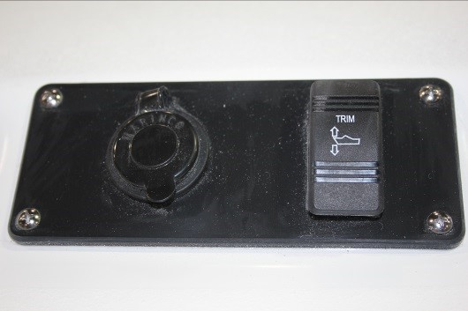
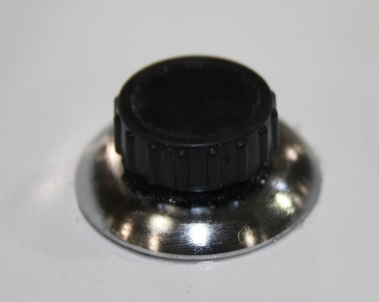
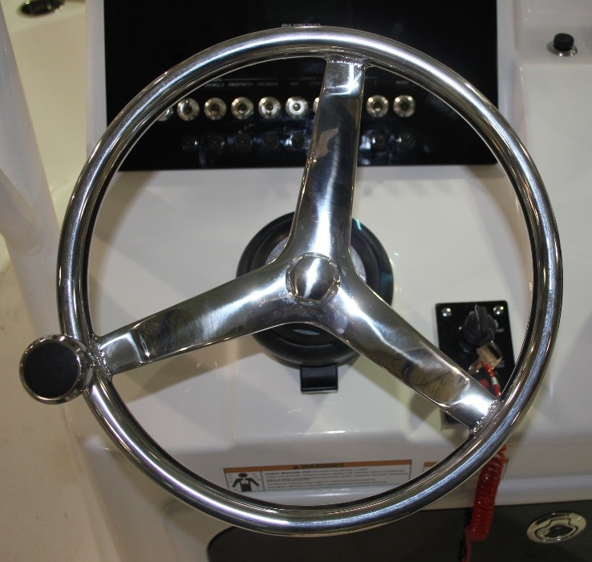
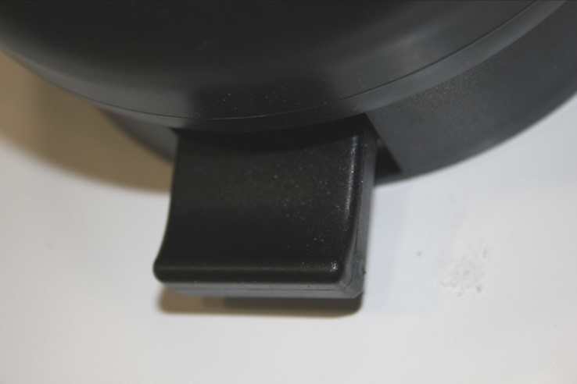
SYSTEMS & COMPONENTS
There is a secondary Trim Control located at the Bow, in
the panel provided for the plug in of a trolling motor.
This rocker switch will allow
the operator to adjust the Trim of the motor while operating the vessel during trolling, and during fishing activities.
Steering Controls:
Your SEA PRO boat has been equipped with a Stainless Steel Steering Wheel and Hydraulic
Steering System. The helm
unit includes a reservoir and pump that pumps hydraulic fluid to the steering cylinder located on the motor bracket causing the motor to turn.
5-Position Tilt:
The Steering System also includes a Tilt Wheel Feature, which allows the operator to position the
steering wheel in five positions for comfort. Activate the tilt lock lever below the steering wheel to adjust the position. Releasing of the lock lever will lock the steering wheel into the desired angle and position.
Easy Access Reservoir:
There is a reservoir fill cap located on the helm for adding hydraulic fluid and for service.
If your SEA PRO boat has been equipped with a steering system other than hydraulic, please refer to the Engine Owner’s Manual for Operation, Maintenance and Specifications.
20
248 BAY SERIES

Slide 21
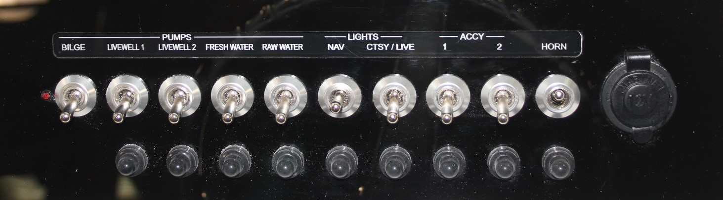
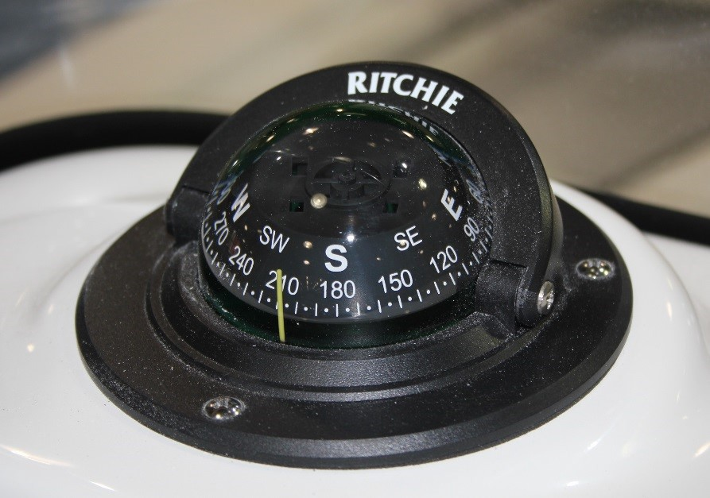
SYSTEMS & COMPONENTS
Helm Switch Panel:
The Helm Switch Panel contains all of the Activation Switches and Circuit Breakers that control the Horn and 12-volt features installed on your vessel. This panel also includes a 12-volt Power Accessory Port. The circuit
breaker for each switch/function is located directly below that switch, and can be reset by pushing in the button.
LIGHTS - CTSY/LIVE: This is a three-positon switch.
Middle is the Off position. Up activates all of the vessel’s courtesy lights as well as the livewell lights. Down activates only the livewell lights.
ACCESSORRY - 1, 2, and 3: These activate any 12-Volt Custom installed features or equipment
HORN: Activates the vessel’s horn and has an auto- reset position feature
The 12-Volt Power Accessory Port maintains power as long as the Battery Selector Switch is in an “on” position.
Compass:
Your SEA PRO boat comes standard with a Explorer Surface Mount compass. Please refer to the compass instructions for compensating and adjusting your compass once all electrical equipment and unique
electronics are installed in your vessel, and once the vessel is located in it’s operational area.
FPO
PUMPS - BILGE: Activates the bilge pump located in the bilge
PUMPS - LIVEWELL 1 & LIVEWELL 2: Activates the pumps that supply water to the livewells
PUMPS - FRESH WATER: Activates the pump that supplies
fresh water to the boat’s fresh water & shower system
PUMPS - RAW WATER: Activates the pump that supplies raw water to the boat’s washdown system
LIGHTS - NAV: This is a three-position switch. Middle is the Off position. Up activates the Navigation,
Instrumentation and Compass lighting. Down activates only the Anchor Light
248 BAY SERIES
21

Slide 22
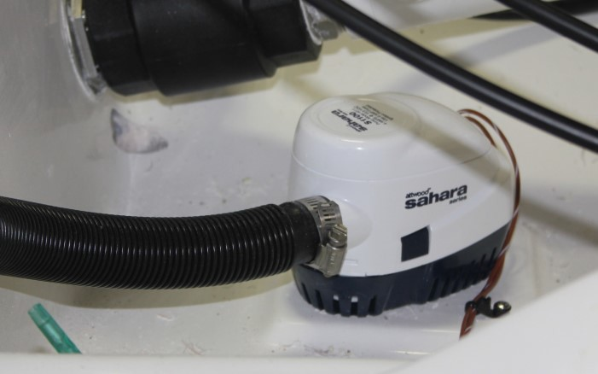
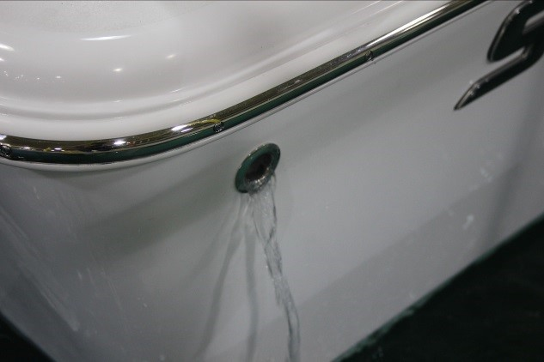
SYSTEMS & COMPONENTS
Bilge Pump:
The Bilge of your SEA PRO boat can be accessed through the Bilge Door located just forward of the transom.
A Bilge Pump has been installed to remove any excess water accumulation that may collect during operation in rough waters, due to weather conditions, or other scenarios.
The bilge pump can be manually operated with the switch located on the Helm Switch Panel labeled “PUMPS -
BILGE”, and is also automatically activated by a Free-Float switch that turns the pump on when water collects inside of the bilge to a predetermined level. This allows the pump to perform it’s operation when the vessel is left unattended.
The water will exit the bilge via a Thru-Hull fitting located on the starboard side of the vessel, at the rear.
NOTE: The bilge pump is wired to have a constant power supply from the batteries, even when the Battery Selector Switch is turned to the “OFF” position. This allows the
bilge pump to operate when the vessel is left unattended. It is important to keep debris and build up away from the
Free-Float switch to prevent unnecessary pump operation and drain of the batteries.
NOTE: Regulations prohibit the discharge of fuel or oily waste in the navigable waters of the U.S. The bilge pump is not intended to pump fuel or oily waste overboard. If there is a build up of fuel or oily waste in the bilge, use other methods of removal or seek the assistance of a
marine service professional.
Refer to the Bilge Pump Owner’s Manual for further instructions, maintenance, and specification
information.
22
248 BAY SERIES

Slide 23
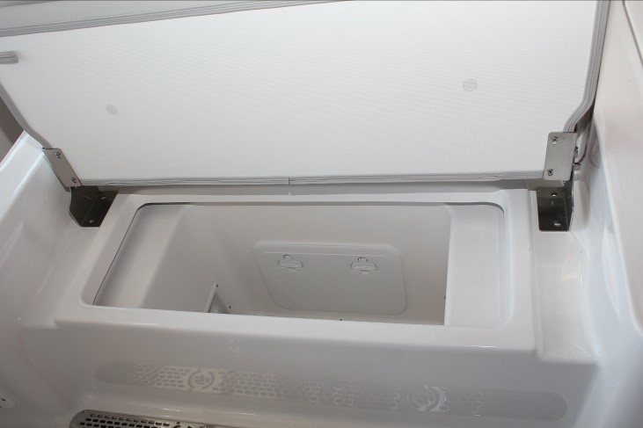
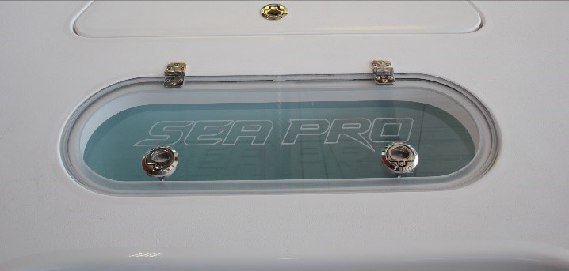
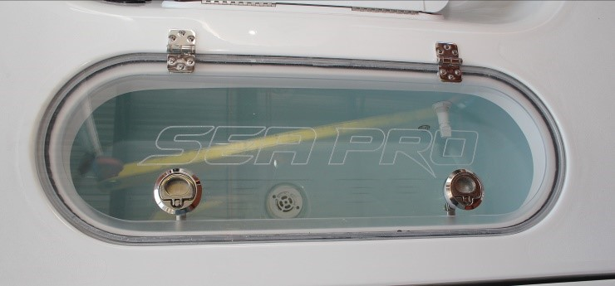
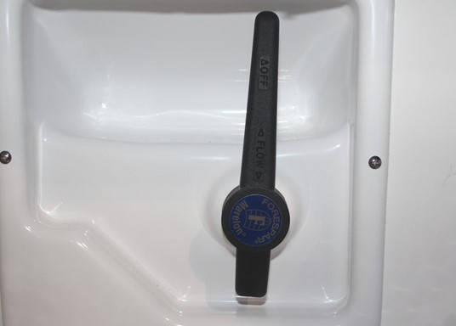
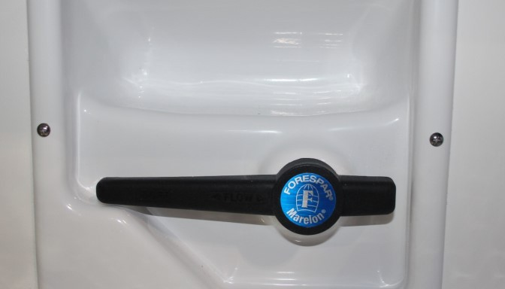
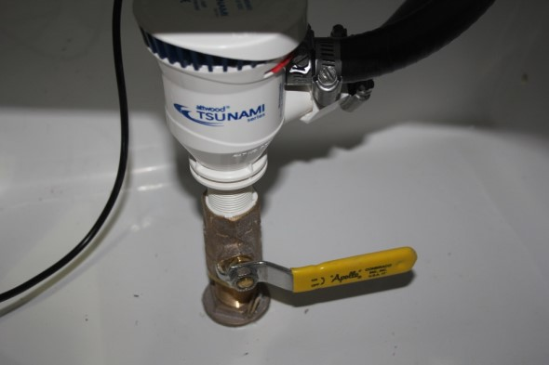
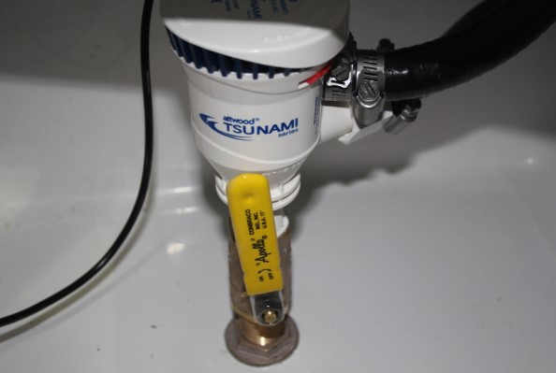
SYSTEMS & COMPONENTS
Live Wells:
Your SEA PRO 248 BAY BOAT is equipped with two (2) 30- gallon pressurized Full-Fill livewells, one located on the forward deck, and one located on the stern deck.
Located under the rear bench seat are the drain valves for each of the livewells. The port valve controls the livewell located at the bow
(forward livewell), and the starboard valve controls the aft livewell.
These livewells come with a customized clear acrylic lid with the SEA PRO logo engraved into the acrylic.
The full-fill, pump operated, feature reduces water turbulence inside of the compartment, providing a more stable environment, thus reducing stress and fatigue and resulting in healthier, longer lasting bait.
CLOSED
OPEN
The drain valves are closed when the handle is in a Vertical position, and are open when moved to a Horizontal position.
Prior to operating your livewell pumps, ensure you have performed the following steps for each of the livewells you intend to use:
Open the Seacock located at the bottom of the pump. This allows water to enter the pump via the thru-hull fitting. Running your livewell pump dry could result in damage to the pump.
Close the Drain Valve by moving the valve handle into a Vertical position. This will close the drain and allow water to fill the livewell tank.
The Livewell pumps and seacocks can be accessed through the lazzarette door located in the floor of the cockpit.
CLOSED
OPEN
The seacock is closed when the handle is in a horizontal position, and is open when moved to a vertical position.
248 BAY SERIES
23

Slide 24
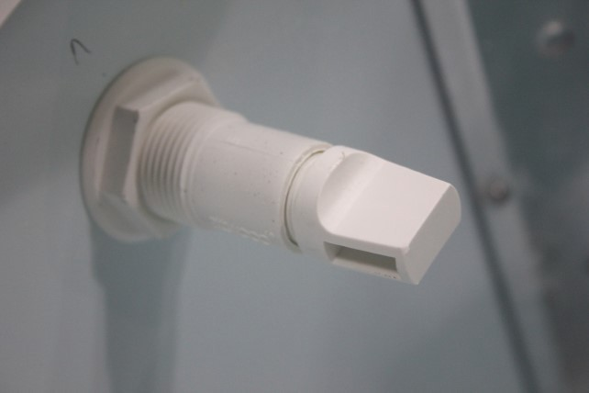
SYSTEMS & COMPONENTS
Open the flow control valve (rotating counter- clockwise), located at the top of the livewell, to allow water to flow from the pump into the livewell.
Turn the livewell pump on by flipping the switch on the Helm Switch Panel that correlates to the livewell you are intending to operate.
Once the water is pumping into the livewell, and has filled the tank completely, adjust the flow control valve to regulate the flow of water so there is a balance
between the incoming water flow and the exiting water
flow through the overflow valve. Rotating counter- clockwise will open the valve, allowing more flow, while rotating clockwise will close the valve, reducing the flow.
To drain your Livewells, flip the switch on the Helm Switch panel to turn the pump off, close the seacock, and position the drain valve to a Horizontal position in order to open the valve.
Refer to the Pump Owner’s Manual for further instructions, maintenance, and specification information.
24
248 BAY SERIES

Slide 25
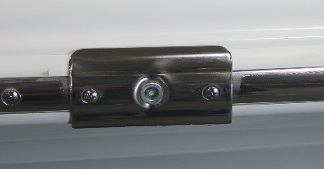
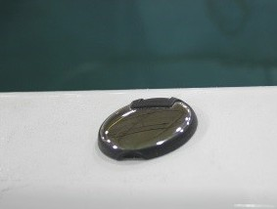
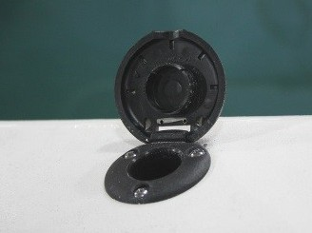
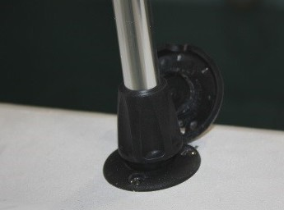
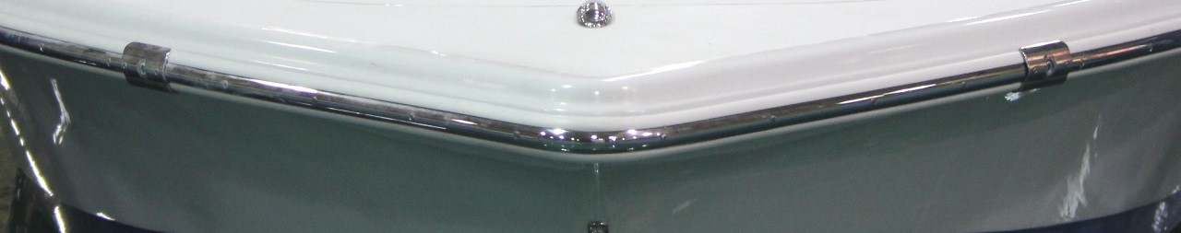
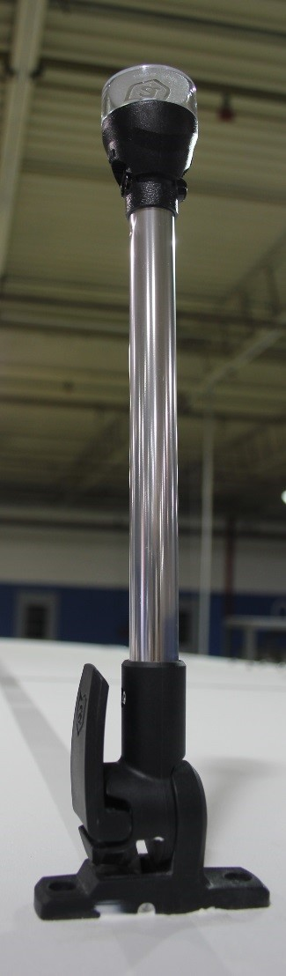
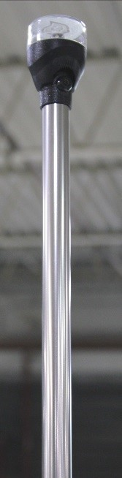
SYSTEMS & COMPONENTS
Navigation / Anchor Lighting:
Your SEA PRO boat has been equipped with navigation lights that are required by the U.S. Coast Guard. The use of navigation lights are required during the time
between sunset and sunrise, and during any period of
For vessels without a T-Top:
The mounting receptacle is located at the stern, on the starboard side of the vessel. Flip open the cover and insert the 360º Light Pole and rotate clockwise to lock into place.
low visibility (fog, rain, etc.).
The sidelights on your vessel are bright LED’s and have been
incorporated into the rub rail and located at the bow.
To activate the Navigation Lights, flip the 3-way switch on
For vessels with a T-Top :
If your vessel has been outfitted with a T- Top, this 360º light will be located on the top, at the rear. The light is mounted on an adjustable, lever-lock, base that allows it to be stowed in a horizontal position, and then raised into a vertical position for use. Unlock the base by flipping the lever down, position the light as desired, then flip up the lever to lock into place.
the Helm Switch Panel labeled “LIGHTS - NAV” Up.
The starboard (right) side light is GREEN and the Port
(left) side light is RED.
The 360º all-around/anchor light is also LED and is WHITE, and it mounted on a stainless steel pole.
248 BAY SERIES
25

Slide 26
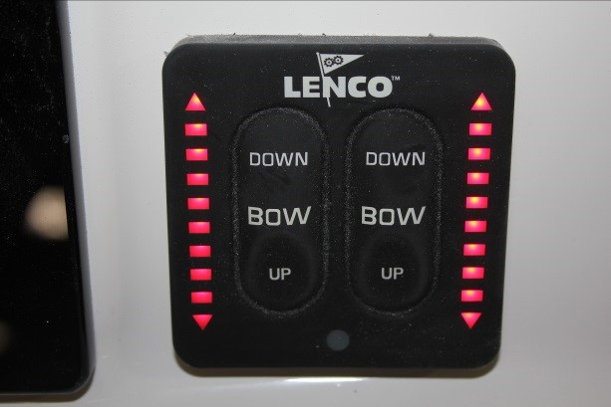
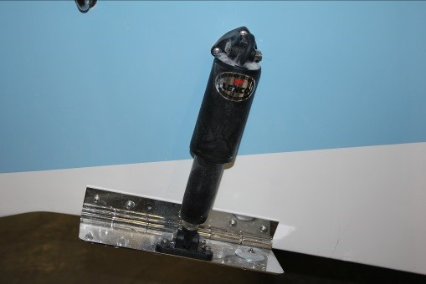
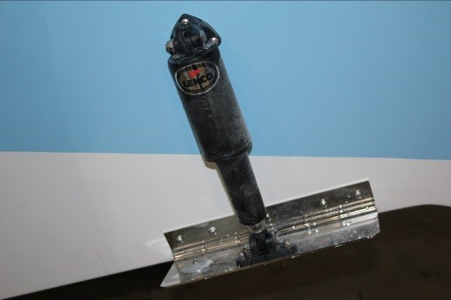
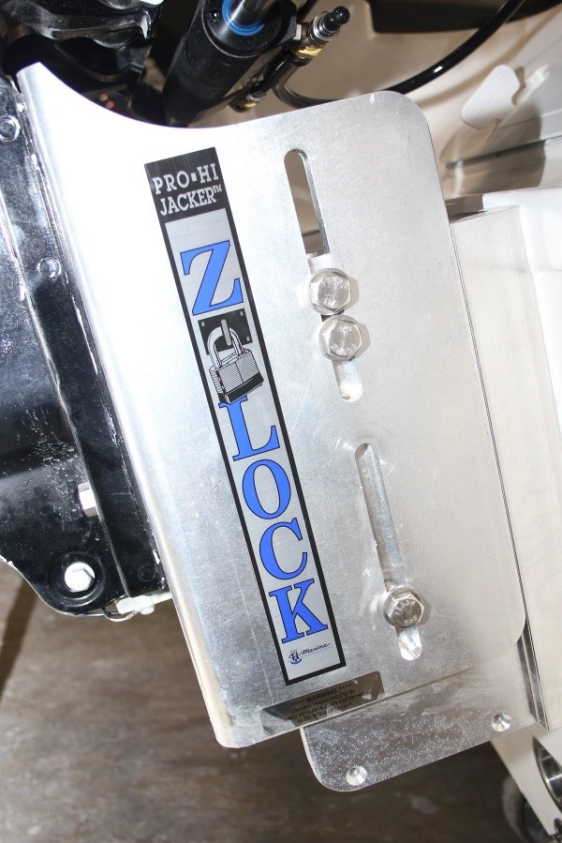
SYSTEMS & COMPONENTS
Trim tab Control:
Trim Tabs are an option that may be installed on your SEA PRO boat. The Trim Tabs will be attached at the transom, close to the bottom edge, Port and Starboard.
The Port and Starboard Trim Tabs can be operated independently. LED’s provide visual indication of the position of each tab, and control labels indicate BOW Down or UP operation.
Refer to the Owner’s Manual for further operation, maintenance and specification information.
Static Jack Plate:
A “Static” (manually adjusted) Jack Plate has been installed on your SEA PRO boat as a standard feature. A Jack Plate can improve the
performance of any boat by allowing you to raise and lower your
outboard motor, positioning the
motor height in a precise position for the current conditions.
The Z-LockTM Manual Jack Plate;
eliminates side to side slippage.
Has 5” of vertical adjustment.
Made from Aircraft Grade Aluminum.
248 BAY SERIES
Trim Tabs are used to adjust the level of the vessel fore (front) and aft (back), thus adjusting how the vessel performs while in operation. “trimming” the tabs down causes upward pressure of the water to increase the riding level of the transom, which will lower the bow. Benefits of a properly “trimmed” boat can:
Increase operator visibility
Decrease time required to get vessel on plane
Increase fuel economy
Decrease wear on the engine
Improve steering operation
Increase speed and performance
Balance weight distribution
Correct listing caused by strong cross winds
Improve handling in choppy or rough water The control panel for the Trim tabs is located on the Helm.
26

Slide 27
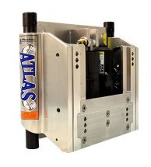
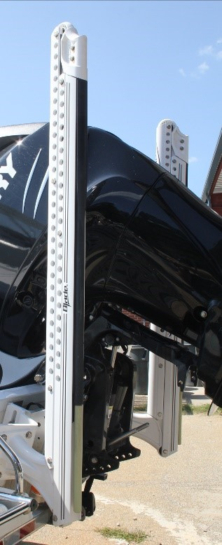
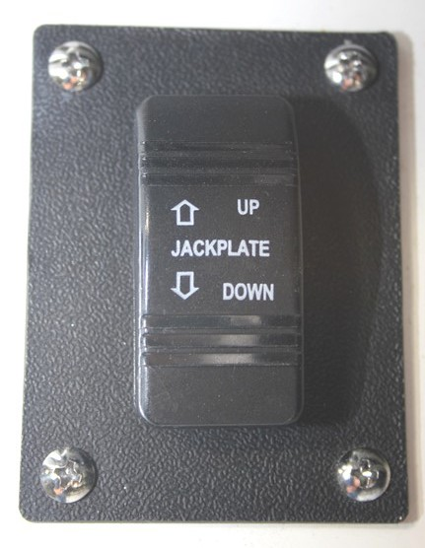

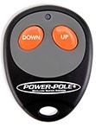
SYSTEMS & COMPONENTS
Hydraulic Jack Plate:
A hydraulically controlled Jack Plate is and optional feature that may have been added as an equipment upgrade. The ATLAS™ Hydraulic Jack Plate;
Can lift the motor from
bottom to top in less than 8 seconds.
Has a self contained hydraulic pump system (no reservoir or lines to install)
Has 7” of vertical adjustment.
The control switch panel is located on the helm and provides the operator with the ability to adjust the height of the Jack Plate on-the-fly with the hydraulic pump. This is a toggle activated switch.
Top performance comes from a combination of Engine Trim and Engine Height. All boats differ as to what the best combination is.
Refer to the Jack Plate Owner’s Manual for further operation, maintenance and specification information.
Power-Pole®:
Your SEA PRO boat may have a Power-Pole® shallow water anchor system installed as an optional equipment upgrade. The Power-Pole® system uses a hinged light weight metal arm that extends down and away from a the boat’s transom.
A hydraulic pump drives the integrated fiberglass spike into the bottom to hold the boat in the prime position. The Power- Pole® Blade™ edition is stronger, faster, and better. You can securely stop on
command in a depth up to 10 feet. Anchor lengths come in either 8 or 10 foot lengths, and hold in fresh or saltwater. The rugged Everflex™ spike is virtually
unbreakable and stows away quickly and quietly into the pocket design of the aerodynamic system.
The system comes with two control units.
The Surface Mount Switch is traditionally mounted on the helm and features three speed settings, independent control of multiple anchors and a double click Auto Up/ Down feature.
The take anywhere Key Fob features Manual or double-click Auto Up/ Down controls
27
248 BAY SERIES

Slide 28
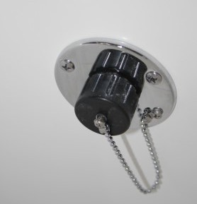
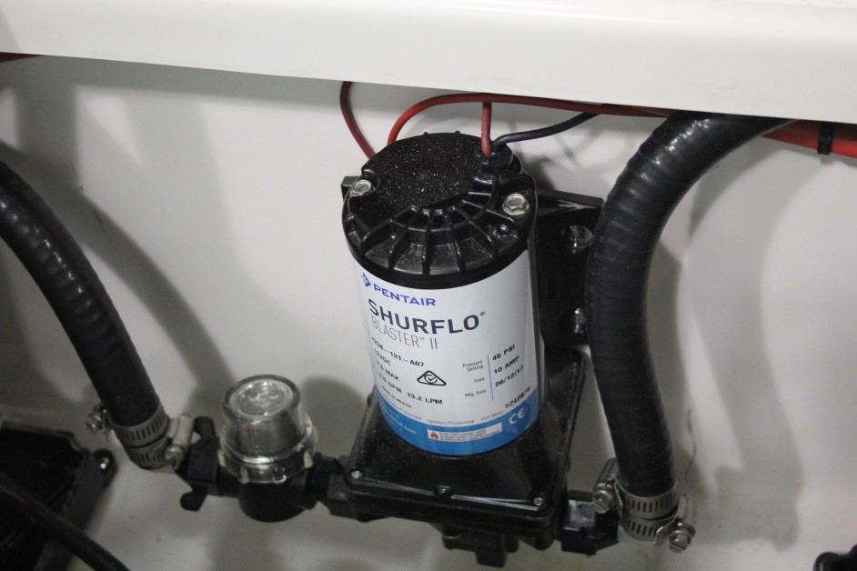
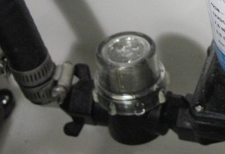

SYSTEMS & COMPONENTS
Raw Water Washdown:
Your SEA PRO 248 is equipped with a Raw Water washdown feature. The ability to rinse down the deck and other parts of the boat helps to maintain the condition, cleanliness and value of your boat. The system supplies water from a pump via a thru-hull fitting and seacock to a standard hose connection.
The pump is located in the Lazzarette compartment, in the cockpit, along with the livewell pumps. The washdown pump accesses water through the same seacock and thru-hull fitting as the port livewell pump. Therefore
it is imperative that the seacock lever be in the open
position prior to using the washdown system. The washdown pump is activated by the “PUMPS -
WASHDOWN” switch located on the Helm Switch Panel.
The water outlet and standard garden hose connection
The outlet connection includes a tethered cap that should remain in place on the outlet when the system is not in use.
1. Open the Seacock located at the bottom of the port livewell pump. The seacock is closed when the handle is in a horizontal position, and is open when moved to a
vertical position.
OPEN
Remove the water outlet cap and connect a hose with a standard garden hose fitting.
Activate the pump by flipping the switch on the Helm Switch Panel labeled “PUMPS - WASHDOWN”.
Regularly check all fittings and connections for leaks and periodically check the inline strainer located at the pump and clean when necessary..
Be sure to remove the hose, replace the outlet cap, and close the port livewell pump seacock when use of the washdown system is complete.
Refer to the Pump Owner’s Manual for further instructions, maintenance, and specification information.
248 BAY SERIES
are located at the aft, below the starboard
storage compartment. It
will be next to the deluxe tackle storage compartment if your SEA PRO 248 has been outfitted with them.
FPO
28

Slide 29



SYSTEMS & COMPONENTS
Fresh Water System:
Your SEA PRO 248 may be equipped with an optional Fresh Water Tank and Shower system. A freshwater pump delivers water to fixtures onboard the boat. Pressurized water systems make life aboard more comfortable by providing water “on tap” for showers and other applications.
The Fresh Water Tank Fill Cap and Inlet and the Shower Unit Cap and Hand-held Shower are located on the port side of the Helm Station.
Shower Unit Cap
Fresh Water Tank Fill Cap
the helm, mounted on the port side helm wall.
Turn the pump on to pressurize and use the system by flipping the switch on the Helm Switch Panel labeled “PUMPS - FRESH WATER”
It is always a good idea to completely drain the remaining water from the fresh water tank after each outing. This will ensure that there is no standing water to become stagnant and not usable. It is recommended to sanitize the fresh water tank and system as part of a regular
maintenance schedule.
To sanitize this system:
Dilute 1/4 cup of household bleach for each 15 gallons of capacity into a gallon of water. Add this solution to the tank and Fill with fresh water.
Let stand for three hours.
Completely drain the tank using the shower unit.
Fill the tank with clean fresh water, and let stand for an additional two to three hours.
Completely drain the tank.
If there is a smell of bleach remaining in the tank, perform an additional fresh water rinse.
To access and use the hand-held shower unit, flip the Shower Unit Cap up and gently withdraw the Shower Unit from the compartment. Note the position of the trigger so that replacement and storage of the Shower Unit is correct.
The pump for the Fresh Water System is located inside of
248 BAY SERIES
29

Slide 30
SYSTEMS & COMPONENTS
Fuel System:
Diurnal Vapor and Emission Control Integrated Fuel System:
Your SEA PRO boat has been outfitted with a Technologically Advanced marine fuel system that
exceeds the Performance, Safety and Environmental Protection Criteria as outlined and required by the Environmental Protection Agency, U.S. Coast Guard and Marine Industry standards and practices. This fuel system meets Fuel Tank Permeation requirements, Hydrocarbon Emission controls, Proper Fuel Vapor
Release and Elimination of Fuel Spit-Back events.
What is Diurnal Vapor?
The temperature variation that occurs during the normal day-night cycle of each 24 hour day is called a Diurnal Temperature Cycle. The heat of ambient air during the day can cause gasoline temperatures to rise inside of a tank, causing fuel expansion and an increase of fuel vapors.
This fuel expansion and increase in vapors can increase pressure build up in a fuel tank and system causing the following problematic issues to occur;
Fuel Tank Vapor Permeation: During the height of a diurnal cycle, a tank that has been
manufactured using a permeable (permitting liquids or vapors to pass through) material will
release more fuel vapors into the environment
than allowed by regulations.
30
Hydrocarbon Emissions released into the atmosphere: Improper venting and vapor control can allow untreated hydrocarbon
emissions to be released into the atmosphere.
Fueling Spit-Back and Spillage: over-filling of fuel and the unchecked increase in pressure can cause fuel to dangerously spit back through the fueling fill cap onto the operator and polluting waterways and the environment.
The Fuel Tank in your SEA PRO boat has been
manufactured using a ceramic coated aluminum. This tank material increases the fuel system’s performance;
The ceramic coating helps to insulate the fuel tank contents which decreases the temperature variance, decreasing the effects of fuel expansion and fuel vapor pressure increases.
Tank structure strength and consistency also helps to decrease the effects of fuel expansion and fuel vapor pressure increases by creating physical stability.
Most marine fuel systems can be broken into two categories, Passive Purge and Vapor Pressure Relief. most recreational vessels have either one or the other installed as it’s primary system to control Diurnal Vapor. Your SEA PRO boat has been built with a Hybrid Fuel system comprised of BOTH of these.
The Fuel System Diagram on the next page has each component labeled and shows the configuration of the SEA PRO Hybrid Fuel System.
248 BAY SERIES

Slide 31




SYSTEMS & COMPONENTS
Fuel System Diagram:
Fuel Vapor
Deck Fill / Vent Com- bination Cap
P-Trap & Thru Hull Exit
Carbon Canister
Deck Fill Inlet
Fuel Inlet Control Valve (In-Line or On-tank)
Grade Valve
Fuel Limit Vent Valve
Fuel Tank
Anti Siphon Valve
248 BAY SERIES
31

Slide 32

SYSTEMS & COMPONENTS
Diurnal Vapor and Emission Control Integrated
Fuel System Performance:
Normal Fuel Filling Event:
the fuel nozzle is inserted into the Fuel Inlet, and as fuel begins to enter the tank, there will be a slight immediate increase of tank pressure that is managed as the Fuel Limit Vent Valve vents air and fuel vapors;
⇒through the Carbon Canister and ultimately out through the P-Trap
⇒and the through the fuel Vapor & Fresh Air Vent line and out through the vent in the Fuel Cap
When the fuel level reaches the Fuel Limit Vent Valve Sensor, at a pre-determined safe level, the valve closes and halts the exiting air and fuel vapors. This causes an immediate increase in pressure that triggers the Inlet Control Valve to close, stopping the flow of fuel into the tank. When the Inlet Control Valve closes, the fuel fills the inlet line, reaching the filling nozzle. The fill nozzle will turn off and the fuel flow will stop when the tank is full and prior to fuel spitting back out of the deck fill.
After the filling event is complete, the pressure will gradually decrease inside of the tank, the Inlet Control
Valve will open, and the balance of the fuel in the inlet
line will be released into the tank.
Diurnal Emission Control:
When the ambient temperature increases, fuel expansion occurs and vapor pressure increases. The Fuel Limit Vent Valve will allow the emissions to escape through the Carbon Canister, which scrubs and cleans the fuel vapor
32
of the harmful hydrocarbons, and releases it through
the P-Trap.
If the tank is filled to the level that causes the Fuel Limit Vent Valve to close, the Grade Valve will allow the
emissions to travel the same path, through the Carbon Canister and through the P-Trap.
When the ambient temperature decreases, the contents in the fuel tank will condense. Fresh air is allowed to enter through the P-Trap, the Carbon Canister, the Fuel Limit Vent Valve and into the tank, allowing the system to
breath, stopping a potential vacuum effect.
Over Pressurization or Prolonged Inclination of the Fuel Tank:
Due to extreme temperature fluctuations, or a prolonged period of inclination, the fuel level of vapor pressure could cause both the Fuel Limit Vent Valve and the Grade Valve to close, halting the normal vapor escape. Pressure will continue to build inside of
the tank, and will build above the Fuel Inlet Control Valve. This creates a potentially unsafe environment. To alleviate this situation, there are sensors
built into the Deck Fill Cap that will open the vent valve inside of the Deck Inlet, releasing the pressure and relieving the
system. Once the cause is corrected, the system will return to the normal venting operation.
248 BAY SERIES

Slide 33

SYSTEMS & COMPONENTS
If the P-Trap is closed or blocked from allowing vapor to escape through the system, the vapors will escape through the Fuel Vapor & Fresh Air Vent line, and through the vent in the Deck Inlet.
Fuel / Water Separator:
Every SEA PRO boat is fitted with a Fuel / Water Separator. This filter is located in the bilge compartment, and normally
mounted to a vertical wall or surface.
Water is the most common contaminant found in fuel, and is common found in the fuel system of recreational vessels.
Ethanol-boosted gas attracts water in vessels that go unused for prolonged periods.
The air space inside of a fuel tank that is less-than- full contains moisture. Over time, moisture condenses inside of the tank.
Water can intrude fuel storage tanks through poorly sealed fuel caps and vents.
Water can be introduced into the fuel directly by the supplier.
Water is heavier than fuel, and over time, water can collect at the bottom of the fuel tank with the fuel floating on top. This water will enter the fuel lines going to the engine and must be removed in order to protect
248 BAY SERIES
the engine. Water can rust and corrode internal engine parts. Microbes can grow in the presence of water, creating sludge and clogging the engine and it’s components.
The fuel travels into the Fuel / Water Separator and through a coalescing micron filter that changes small
water particles into larger droplets. Being that water is heavier than fuel, these droplets fall by gravity, to the lower part of the filter, with the clean fuel floating on top. The clean fuel exits the top of the separator and on to the engine.
It is imperative to regularly inspect the bowl, or lower part, of the separator. As the separator performs it’s job, water will continue to collect in the lower unit.
Eventually, if the water is not drained from the unit, and
it collects to the top of the exiting connection, contaminated fuel will begin to travel to the engine causing performance issues and potential damage.
It is also recommended to change your Fuel / Water Separator’s filter media during regular service intervals.
It is YOUR responsibility to determine maintenance and care intervals based on your usage of the boat and the operating environment.
Refer to the Engine Manufacturer Owner’s Manual for further instructions, maintenance, and specification information, or contact your local SEA PRO BOATS
authorized dealer for assistance and further
information.
33

Slide 34
SCHEMATICS & WIRING DIAGRAMS
WIRING COLOR CODES:
ANC LIGHT | GRAY/WHITE
BILGE (AUTO) | BROWN/ORANGE
BILGE (MAN) | BROWN
COMPASS/BACK LTS | BLUE
COURTESY/BOX LTS | BLUE
FRESH WATER | BROWN/BLUE
FUEL | PINK
FUEL FILL BOND | GREEN
HORN | ORANGE/WHITE
LIVEWELL #1 | BROWN/WHITE
LIVEWELL #2 | BROWN/YELLOW
LIVEWELL LTS | BLUE/WHITE
MACERATOR | BROWN/GREEN
NAV LIGHT | GRAY
PORT FRONT SPKR - | WHITE/BLACK
PORT FRONT SPKR + | WHITE
PORT REAR SPKR - | GREEN/BLACK
PORT REAR SPKR + | GREEN
RAW WATER | BROWN/BLACK
STBD FRONT SPKR - | GRAY/BLACK
STBD FRONT SPKR + | GRAY
STBD REAR SPKR - | PURPLE/BLACK
STBD REAR SPKR + | PURPLE
UNDER WATER LTS | BLUE/RED
BATT POSITIVE | RED
48
248 BAY SERIES

Slide 35
MAINTENANCE
Routine Care & Maintenance:
NOTE: Refer to the individual Manufacturer Owner’s Manuals for detailed information related to Service, Care, Maintenance and Repair of those specific components.
Routine inspection and maintenance of your SEA PRO
boat and it’s systems ensures safe boating experiences and
prolongs the life of your boat and it’s systems.
The following information is for general guidelines only. It is YOUR responsibility to determine maintenance and care intervals based on your usage of the boat and the operating environment. This information may not cover all systems or additional components that have been
customized or installed by the dealer or owner.
Hull Exterior: Algae and Slime growth can affect the performance and overall look. This growth can be removed with a coarse towel or soft
bristle brush. If the growth is severe, or has been allowed to dry and harden on the boat surfaces, it may be necessary to seek the services of a professional hull cleaning company. Refer to your SEA PRO BOATS authorized dealer for assistance.
Gel Coat: The gel coat will be protected and last longer with regular cleaning and waxing. It is recommended to wax your exterior surfaces at least twice per year. Your usage and operating
environment may dictate additional waxing intervals. Do not wax over growth or surface
34
dirt / debris, ensure your SEA PRO boat has been thoroughly washed and rinsed prior to waxing. Use a high quality was designed for marine gel coats. Refer to your SEA PRO BOATS authorized dealer for suggested brands.
General Hull and Deck Surface Washing: Always use a cleaning agent that is suggested for use on marine gel coats. If using a pressure washer to clean these surfaces, it is important that a Wide Pattern nozzle is used, and the spry head is continuously in motion. Do not concentrate high pressure on a small area. A pinpoint nozzle or concentrated stream could damage the finish and surface of your boat. SEA PRO BOATS does not recommend pressure washing of the Helm and Console. Damage could be done to the
electronics, gauges, and controls.
Stainless Steel Trim & Fittings: Even though stainless steel is corrosion resistant, it still requires care and maintenance. The presence of salt particles can cause spots, pitting and corrosion. Frequently wash and clean the stainless steel trim and fittings with a mild soap or solution suitable for use on stainless steel. A coating of cleaning wax will help maintain the finish and sheen. Apply with a clean, soft cloth, allow to dry, then polish and buff with additional clean, soft cloths. Never use abrasive cleaners, abrasive pads, or strong solvents.
248 BAY SERIES

Slide 36
MAINTENANCE
Cushions and vinyl materials: Saltwater, dirt, debris, chemicals, and UV rays can cause damage to these materials over time, causing them to discolor, lose their texture, and tear. Remove ordinary dirt and surface debris with a mild detergent and a soft cloth. More stubborn stains can be removed with a solvent solution. Refer to your SEA PRO BOATS authorized dealer for assistance and suggestions. To prevent
mildew, keep these surfaces dry and do not let
moisture accumulate and stand for long periods of time.
Tempered Glass Windshield: Always use a
commercially available glass cleaner or a mixture of water and vinegar to clean your windshield.
Dry and polish the glass with soft cloths. Never use harsh chemicals or abrasive materials.
Instrumentation and gauges: Never use abrasives or harsh chemicals, as these will cause damage to the surface and components. Refer to the specific Manufacturer Owner’s Manual for detailed cleaning procedures.
Battery: Always turn the Battery Selector Switch to the “OFF” position prior to servicing the battery. Ensure the battery terminals are clean. Ensure the cable connections are tight, secure and clean. When removing a battery from the
boat, remove the Negative (-) cable first. When re- installing a battery, always attach the Negative (-) cable last. Refer to your Battery Owner’s Manual
248 BAY SERIES
for proper cleaning of the terminals and
maintaining proper fluid levels. Batteries will self-discharge during extended periods of non- use, and should be recharged properly prior to being put into service. Disconnect the battery terminals (Negative (-) first) and remove the battery from the boat for proper recharging according to the Battery Owner’s Manual.
Steering Controls: Inspect and check the hardware and connections at the helm, stern and engine to ensure they are tight and leak-free. If your boat has a hydraulic steering system installed, regularly check the fluid reservoir and top off as necessary.
Hardware, Fasteners and Fittings: Regularly clean all hardware, hinges, latches, cleats and fittings with approved marine cleaners or a mild soap solution. Ensure all fasteners are tight and secured. Repair or replace any items that need attention. As with Stainless Steel, a marine grade wax application can extend and maintain the finish and sheen.
Aluminum Hardware: Frequently wash and clean the aluminum hardware with a mild soap or solution suitable for use on aluminum. A coating with aluminum metal protectant or A coating of cleaning wax will help maintain the finish and sheen. Never use abrasive cleaners, abrasive pads, or strong solvents.
35

Slide 37
MAINTENANCE
Livewells, Coolers, Fish boxes: Rinse and Completely drain the water in these areas after each use. This will help lesson the chance of stagnation and unwanted growth.
To sanitize these compartments:
  Dilute 1/4 cup of household bleach for each 15 gallons of capacity into a gallon of water. Add this solution to the compartment and Fill with fresh water.
  Let stand for three hours.
  Completely drain each compartment.
  Fill each compartment with clean fresh water, and let stand for an additional two to three hours.
  Completely drain each compartment.
  If there is a smell of bleach remaining in the compartment, perform an additional fresh water rinse.
As an alternative to using a bleach solution:
  Mix a few tablespoons of baking soda in a gallon of water. Use the solution with a rag or soft bristle brush to scrub the surfaces of each compartment.
  Completely rinse and drain each compartment using a hose and fresh water.
Seacocks, Pumps & Valves: Regularly check the fittings and valves of each seacock and pump for leaks and proper operation. Clean or replace strainers and filters as necessary.
36
248 BAY SERIES

Slide 38
STORAGE
Storing your SEA PRO boat for an extended period of non
-use requires special preparations to prevent damage to the boat and it’s systems.
The following information is for general guidelines only. Always refer to the manufacturer Owner’s Manuals for specific instructions and information pertaining to those systems and components.
It is always a good idea to consult your SEA PRO BOATS approved dealer or a certified marine technician before performing Winterization and Storage procedures.
Fuel System: Fill the tank completely (100%) full with fresh fuel and add a quality fuel stabilizer, following the manufacturer’s instructions, to provide stability and corrosion protection. This also prevents the formation of varnish and “gumming” of the lines and pump.
Engine: Replace the engine oil and filter. Flush the engine with fresh water and let it completely drain.
“Fog” the engine with a corrosion-preventing fogging oil according to the engine manufacturer’s
recommendations. Run fuel (ensure the fuel system has
been treated with fuel stabilizer) through the engine. This ensures that all fuel lines and the engine contain fuel that has a stabilizer mixed with it.
Lower Unit: Replace gear oil, checking for any moisture which could show a sign of deteriorating seals.
Propeller: Remove the prop and apply a coating of grease
to the shaft and threads.
Grease Fittings: treat all fittings with the recommended
248 BAY SERIES
lubricant.
Fresh Water Washdown: If your SEA PRO boat has a fresh water washdown system installed, turn on the pump, open all connections and outlets, and drain all water from the fresh water tank and lines. Run the pump until the system is completely empty. Add a non-toxic
antifreeze solution to the tank. Run the pump until the antifreeze solution is running out of all connections and outlets.
Raw Water Washdown: Open the seacock that supplies water to the raw water washdown pump allowing all water to drain from the system. Open the cap at the outlet connection. Run the raw water washdown pump for a short time to drain any residual water in the pump and lines. Remove the inline strainer and empty any water in the strainer and lines.
Livewell Pumps & Seacocks: Open all seacocks, allowing all water to drain from the pumps and lines.
Drains, Manifold and Bilge Plug: Open the drain plug and check that all debris has been cleaned and removed from around all drains, the single port manifold, and the
bilge drain plug. This ensures that any moisture that enters the boat can drain properly.
Batteries: Remove the batteries and perform the
necessary maintenance as outlined in the Manufacturer
Owner’s manual. Store the batteries out of the boat and in a safe location. Clean the cable terminals and apply a coat of battery cable grease.
37

Slide 39
RECOMMISSIONING AFTER WINTERIZATION OR STORAGE
After your SEA PRO boat has been winterized or put into
storage, it is necessary to perform proper steps to prepare it for use and operation.
The following information is for general guidelines only. Always refer to the manufacturer Owner’s Manuals for specific instructions and information pertaining to those systems and components.
It is always a good idea to consult your SEA PRO BOATS approved dealer or a certified marine technician before putting your vessel back into service.
Inspect the hull for any damage.
Inspect the battery cables and electrical wiring for any loose connections.
Check the bilge pump and free-float switch for proper operation.
Inspect the fuel system for any leaks or damages.
Check the complete engine for any damage, cracks, or leaks caused by freezing conditions.
Check all hoses, clamps and valves for proper fitting and operation.
Check all compartments and the bilge area for any debris or nesting animals. Remove and clean as necessary.
Install drain plugs, Filters, and in-line strainers.
Install charged and properly maintained batteries.
Fill the fresh water tank and thoroughly flush out all antifreeze solution from all connections
38
and outlets. Drain the system and sanitize the
tank and lines.
Dilute 1/4 cup of household bleach for each 15 gallons of capacity into a gallon of water. Add this solution to the fresh water tank and fill with fresh water.
Let stand for three hours.
Turn on the pump and completely drain the fresh water tank and all connections and lines.
Fill the fresh water tank with clean fresh water, and let stand for an additional two to three hours.
Turn on the pump and completely drain the fresh water tank and all connections and lines.
If there is a smell of bleach remaining in the compartment, perform and additional fresh water rinse.
Check and lubricate the Steering System.
Check all Navigation / Anchor lighting for proper operation.
Check fire extinguishers and all U.S. Coast Guard required safety equipment for proper operation.
Check all controls, gauges, electronics and other
related equipment for proper operation.
248 BAY SERIES

Slide 40

SEA PRO BOATS, LLC LIMITED WARRANTY
Five Year Limited Warranty
Sea Pro Boats, LLC (Sea Pro) warrants to the original purchaser for a period of five years from the date of delivery to the original purchaser that each Sea Pro boat will be free from defects in material and workmanship under normal recommended use.
During the five-year period, warranty repairs will be made without charge by Sea Pro for the first year at its plant in Whitmire, SC or at Sea Pro’s option, by an Authorized Sea Pro Marine Dealer or agent. Transportation charges to and from the place of repair will be the responsibility or the original purchaser. All repairs made under this warranty are subject to the approval of an authorized Sea Pro Representative.
This warranty does not apply to upholstery, electronics, engines, osmotic blistering, stress cracks or parts which have been altered or subjected to misuse or negligence.
This five-year limited warranty extends only to the original purchaser and may not be transferred to subsequent purchasers.
Ten Year Hull Limited Warranty
Sea Pro warrants, to the original purchaser for a period of ten years from the date of delivery to the original purchaser, that each Sea Pro hull will be free from structural defects in fiberglass material and fiberglass workmanship under normal recommended use.
Sea Pro will repair or replace, at its option any Sea Pro hull found to have a structural defect, provided the original purchaser returns the boat to Sea Pro at its plant in Whitmire, SC or at Sea Pro’s option to an Authorized Sea Pro Marine Dealer. Transportation charges to and from the place of repair will be the responsibility of the origan purchaser.
This ten-year hull limited warranty does not apply to non-structural hull surface changes, such as fading, checking, crazing, blisters and gelcoat cracks, This warranty does not apply to hull damage caused by accidents, neglect, unauthorized repairs, items not installed on the boat by Sea Pro at the factory or the boat’s trailer. This warranty does not apply to boats used for or in racing or for governmental, commercial or business use.
This ten-year hull limited warranty may be transferred to subsequent purchaser(s) of the boat during the warranty period provided that the boats passes a re-certification inspection by an Authorized Sea Pro Dealer. Subsequent purchaser(s) shall pay a $300 inspection fee and be responsible for transportation charges to and from the place of inspection. Re-certification is not automatic, and Sea Pro expressly reserves the right to deny re-certification should it determine the boat fails inspection.
Limitation of Liability and Disclaimer
This warranty is in lieu of all other warranties, expressed or implied, including the implied warranties of merchantability and fitness for a particular purpose. Implied warranties, if any, which cannot be disclaimed, are limited in duration to the duration stated above. All other obligations or liabilities, including liability for loss of use, inconvenience, commercial loss, or consequential damages are hereby excluded.
Warranty Registration/Acknowledgement of Limited Warranty
Sea Pro Warranty Registration is a condition precedent to warranty coverage. It is the sole responsibility of the original purchaser to require the dealer to fill out and submit the warranty registration form on the home page of the Sea Pro website (seapromfg.com) within 10 days of the date of sale.
Miscellaneous
Sea Pro reserves the right to alter models, change colors, specifications, materials, equipment, component parts, prices or cease production of certain models at any time without notice. Such changes shall be made without obligations to equip or modify units produced prior to the date of such changes.
.
248 BAY SERIES
36

Slide 41
SEA PRO BOATS
25214 HWY 121
WHITMIRE, SOUTH CAROLINA 29178 (803) 694-2644
EMAIL
ADMINISTRATOR@SEAPROMFG.COM
WEBSITE
WWW.SEAPROMFG.COM

